Slide 1
An Introduction to Linked Data (and OSLC)
Source: http://open-services.net/resources/presentations/introduction-to-oslc-slideshow/,
by Steve Speicher
Modifications: Jad El-khoury (jad@kth.se)
Notes:
This presentation is a slight modification of a presentation by Steve Speicher. You can find the original content at the link above.
My modifications are only
* to adjust to my style of doing a presentation,
* and some very slight updates to OSLC since this presentation was created.

Slide 2
Workshop Objectives
After completing this session, you
Understand the basics of Linked Data
And its supporting technologies (RDF, RDF Schema, …)
Appreciate the purpose of the OSLC standard
Understand its structure and content
OSLC Core specification
OSLC domain specification(s)
Requirement Management – an example
Gained hands-on experience in developing Linked Data adapters
My objective
Feedback & discussion on future workshop(s)
Notes:
2
Why talk about Linked Data? OSLC builds on Linked Data, so you need to understand that approach first.

Slide 3
Pre-requisites
You understand
Basics of web technologies
URI, HTTP, web services, web servers, …
The REST architectural style
For the hands-on tutorial
You are familiar with
Java development
Eclipse environment
Web development
web services, HTML, jsp-files, etc.
Notes:
3
But you can get away even if you have no practical experiences with these technologies.
I will be talking (I hope) about basics.

Slide 4
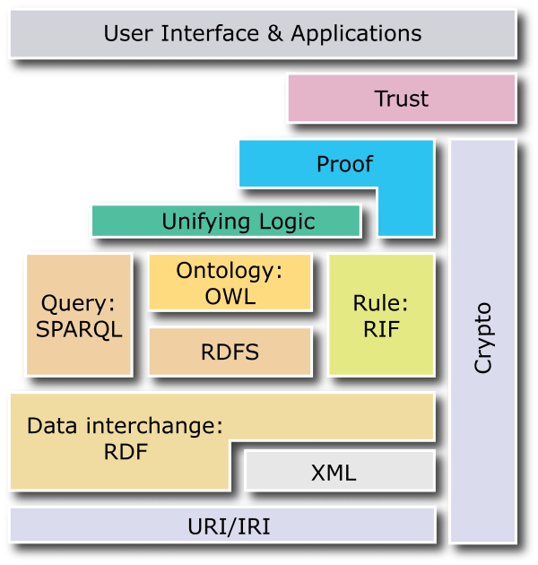
The Linked Data Technology Stack
Plus …
Serialization syntaxes
Turtle, JSON-LD, RDF/XML
Vocabularies
Validation languages
SHACL, Shex
Source: http://www.w3.org/2007/03/layerCake.png
Notes:
There are a lot of technologies we want to cover

Slide 5
Agenda
The Integration Problem
The OSLC approach
Linked Data and RDF
The OSLC standard
Core specification
domain specification(s)
Requirement Management – an example
… Followed by the Linked Data Tutorial
Notes:
5

Slide 6

Who I Am… (A Disclaimer)
Jad El-khoury, PhD
@KTH @ Mechatronics
Researcher (50%)
Teacher (50%)
Research focus
Tool interoperability
Model-based development
Eclipse Committer
the OSLC Lyo project
Member of OASIS OSLC Core TC

Slide 7
What’s next
The Integration Problem
The OSLC approach
Linked Data and RDF
The OSLC standard
Core specification
domain specification(s)
Requirement Management – an example
… Followed by the Linked Data Tutorial
Notes:
7

Slide 8
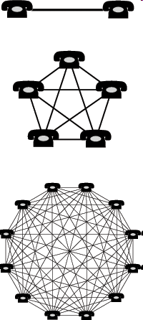
The Integration Problem
Point-to-point
Integrations
don’t scale
Monocultures
lock you in
Maintenance, management,
and change costs go up over time
Ongoing and unexpected
costs drain resources
End-user productivity suffers:
Either stuck with the wrong tool,
stuck doing manual integration;
often stuck doing both
Creating new
integrations is
unpredictable
Past choices
restrict present
action and
future vision
Integrations consume more of the IT budget:
integration failures are the top 2 causes
of software project delays*
More limited ability to respond to change
Constrained by exhausted IT budget and lower productivity
* Commissioned study conducted by
Forrester Consulting on behalf of IBM.
Notes:
What is the problem that OSLC tries to solve?
What are the problems with the previous solutions?
What we have been illustrating, we can call “the integration problem.”
The integration problem has been around since the first user wanted two programs to work together. It has only got worse since software got more capable (and more complex), since groups of users wanted to work together across the different tools, and since businesses became more dependent on software.
1. (blues)
Traditional (point-to-point) integrations are based on proprietary APIs.
This places burdens:
On all vendors to invent their own good API (re-inventing the wheel each time), and
On all integrators (whether they be vendors, IT administrators, or end users themselves) to understand at least two APIs to create any integration.
Experience has shown these integrations to be brittle and difficult to maintain.
For IBM:
Our traditional assumption: 12 months, 6 developers; prototype in 2-3 months
A starting point like that indicates quite a bit of uncertainty about the effort.
2. (blues)
Software monocultures and the “hub-and-spokes” integration pattern, emerged as a way to minimize the negatives associated with traditional integration techniques.
Unfortunately, many ecosystem users then suffer from:
The inability to use the tools they prefer from within the ecosystem, and
The high cost of quitting that ecosystem all together.
In the long run, the ecosystem can become a burden to the dominate vendor as they bend to customer pressure to make sure dozens of external integrations work too.
Whatever software choices we’ve made in the past, integrations have been yet another proprietary data format that has locked us in.
3. (blues)
As time goes by, it isn’t only the visible costs of maintenance, management, and migration that go up:
Users also get frustrated, affecting morale and productivity, and
The lack of agility can result in lost business opportunities.
The costs of supporting these integrations can be near-fatal too!
For IBM:
Integration PMRs are difficult to diagnose (let alone solve!), consuming resources from new initiatives, and making our clients shoulder the burden of investments that are not showing returns.
Customers with low trust that our own products will integrate with each other, let alone 3rd-party tools
Cost (“Integrations consume …”) (see backup slide for stat details):
Special skills required to maintain the integrations
Risky to change any part of the system
Frustrating for IT staff who work to keep the system running for the present instead of innovating for the future
Copy and synchronization problems can be difficult to diagnose
Productivity Better software either unavailable because it isn’t integrated, or used without being integrated
May result in missed business opportunity
Copy and synchronization problems can effect business decisions
Change
The strength that was an integrated software system can become a weakness in the face of smaller, younger, competitors who don’t have to support dozens of special case integrations.
Today’s, and tomorrow’s, profits and competiveness are reduced by the effects on IT spending and user productivity.

Slide 9

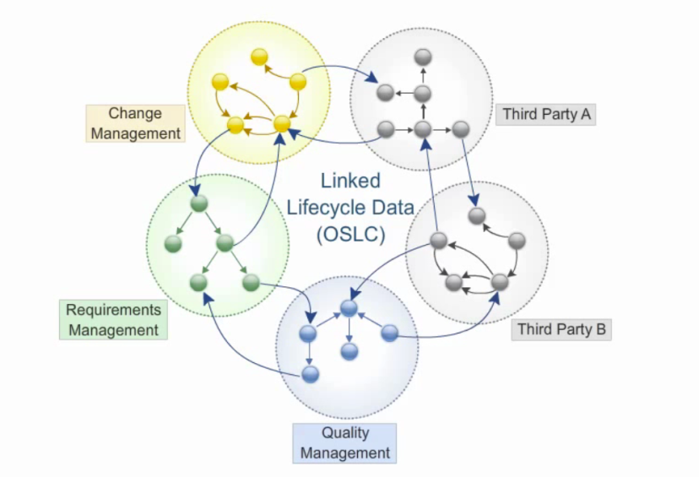
OSLC’s Simple Solution
Users can work seamlessly across their tools
*
*
Architecture of the Web
Standard Interfaces
Automation
*
*
Linked Data
“Just Enough” integration
Increased reuse
Increased traceability
Monitoring
Decreased maintenance costs
Better visibility
OSLC is an open and scalable approach to lifecycle integration.
It simplifies key integration scenarios across heterogeneous tools
* Jad’s highlights
Notes:
OSLC tries to find a balance between these 2 extremes of pt-to-pt & single-platform.
It adopts the Arch of the web … which is very scalable.
In particular, it adopts the Linked Data approach of the web.
It aims to standardize the interfaces…
Minimalistic
You do this everyday! Web browser example. + single web page, data sourced from many places … ads, videos, pictures, tweets, comments, content, more links
Linking to application lifecycle data where it is created, instead of copying and synchronizing between tools, is the key insight of OSLC.
Doing so using standard interfaces, on top of a proven architecture, has helped many realize the value of OSLC already.
With OSLC, instead of worrying about integrating specific tools, we focus on composing a set of capabilities.
Animations (OSLC is …):
Approach to integrations
Philosophy of specification development
Set of specifications that tell you what and how to integrate various capabilities
It is also the open community where all this happens
4. Read
This has benefits to professional users (5), business leaders (6) and creators of integrations (7)

Slide 10
What’s next
The Integration Problem
The OSLC approach
Linked Data and RDF
The OSLC standard
Core specification
domain specification(s)
Requirement Management – an example
… Followed by the Linked Data Tutorial
Notes:
10

Slide 11
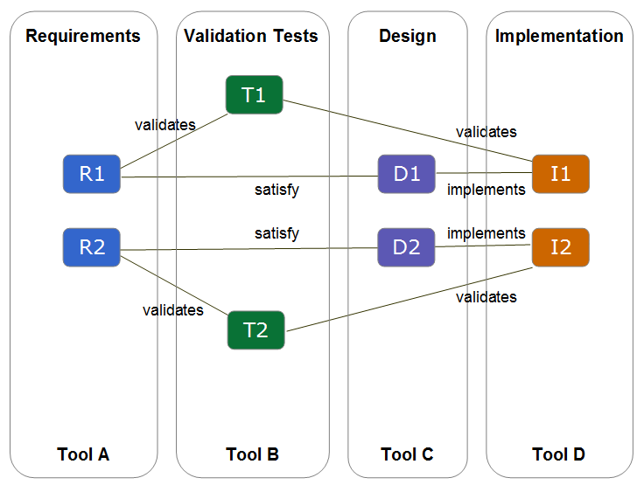
Linked Data
An approach of publishing structured data, such that
Data from different sources can be connected
→ Data gets more meaning
Data from different sources can be queried
→ Data becomes more useful
Notes:
Note that this is about Publishing data. Not some much focus on how to store, manage data internally.
Primary focus on (1) Data and (2) linking data ☺
Data gets more meaning -
Once you can connect data, you are providing data with more information/relations that would not otherwise be available.
Data becomes more useful –
Once you can connect the data, it is no longer isolated. You can make more sense out of it.

Slide 12
Linked Data turns data into...
Requirements
Validation Tests
Design
Implementation
T1
R1
D1
I1
R2
D2
I2
T2
Tool A
Tool B
Tool C
Tool D

Slide 13
...connected information...
Requirements
Validation Tests
Design
Implementation
T1
validates
validates
R1
D1
I1
satisfy
implements
R2
satisfy
D2
implements
I2
validates
validates
T2
Tool A
Tool B
Tool C
Tool D
Does every requirement have a test to validate it?
Which requirements for the UI are related to test cases that failed on their last run?

Slide 14
...that can facilitate applied knowledge
Requirements
Validation Tests
Design
Implementation
T1
User Interface
validates
validates
R1
D1
I1
satisfy
implements
Release
R2
satisfy
D2
implements
I2
validates
validates
T2
Processing Engine
Tool A
Tool B
Tool C
Tool D
Why is the number of failed test cases for the UI increasing in each iteration?
How much faster is work progressing on the UI versus the Processing Engine?
Notes:
Once lifecycle data is linked together, you can then use other tools to perform complex queries of data and analyze trends.

Slide 15
Linked Data Principles
Tim Berners-Lee’s four principles for Linking Data:
Use URIs as names (identity) for things
Use HTTP URIs so that people can look up those names
When someone looks up a URI, provide useful information using the standards (RDF, SPARQL)
Include links to other URIs so that they can discover more things
Notes:
This LD approach builds on 4 principles defined by Tim Berners-Lee in 2006…
Principle1:
To identify things unambiguously
Principle2:
For example, for books you could make a URI like isbn:0140437428.
But, this type of URI is not implemented, and hence applications do not know how to handle/resolve it. (try to paste this URI into your browser and see what happens)
If you use HTTP URIs, you can make them resolvable on the Web.
Principle4:
Data is made even more useful if it contains links to other related data, documents, etc.
That’s what makes Linked Data “linked”

Slide 16
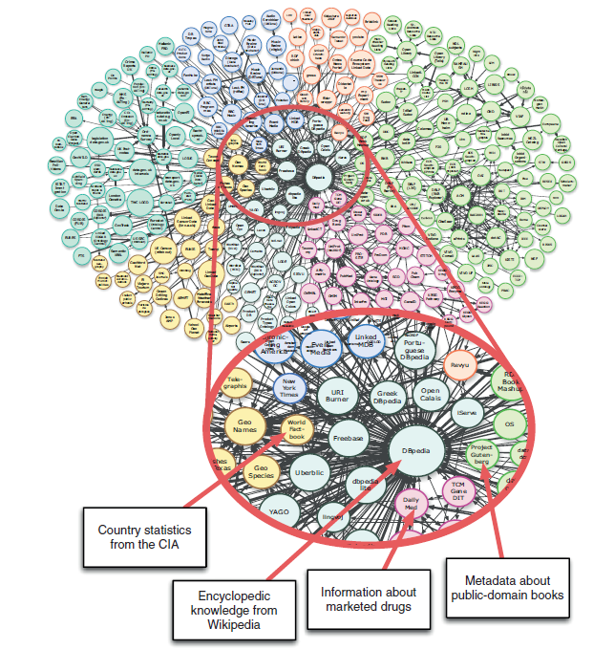
Linked Data Example - The Linking Open Data project
Links data from open-content projects such as
encyclopaedias and dictionaries
government statistics
bibliographic data
music
research papers
…
Access to data & its semantics
No longer Data Silos
Discoverability
Data discovered and used in unpredictable ways
Linked Data - Structured Data on the Web; by David Wood, Marsha Zaidman, and Luke Ruth; Fig 1.5

Slide 17
Linked Data Technologies
Builds upon standard Web technologies
RDF standard(s)
HTTP
URIs
Linked Data
Source: http://www.w3.org/2007/03/layerCake.png
Notes:
RDF is a family of standards.

Slide 18
RDF Standard(s)
RDF (Resource Description Framework)
a standard to describe structured data on the web.
designed to be understood by computers (xml) - not to be displayed to people (html)
Examples of Use
Describing time schedules for web events
Describing information about web pages (content, author, created and modified date)
RDF key concepts:
Graph data model
URI-based vocabulary
Serialization syntaxes
Vocabularies
→ We’ll briefly look at some of them.
Notes:
RDF is an abstract model with several serialization formats (i.e., file formats), and so the particular way in which a resource or triple is encoded varies from format to format.
RDF is:
a simple, powerful data model
used to deﬁne relationships between things
designed to work with the architecture of the web
the data model for the Web of Data

Slide 19
1. The RDF graph data model
Basic structure - The Triple
consisting of a subject, a predicate and an object.
Subject
Object
Predicate
Amanda
owns
Car
Requirement 1
Priority
“High”
The predicate (also called a property) denotes a relationship between the subject and object.
Adapted from:
http://www.w3.org/TR/2004/REC-rdf-concepts-20040210/#section-data-model
Notes:
The underlying structure of any expression in RDF is a triple, consisting of a subject, a predicate and an object.
Each triple represents a statement of a relationship between the things denoted by the nodes that it links. Each triple has three parts:
a subject,
an object, and
a predicate (also called a property) that denotes a relationship.

Slide 20
1. The RDF graph data model
RDF triple (subject-predicate-object)
Triple
Subject
= Resource
(Always a URI)
Predicate
= Relationship/property
(Always a URI)
Object
= Resource
or
= literal value
Requirement 28465 Improve Remote Steering
Test Case 35645: Test Steering
validated by
priority
High
Notes:
Resources:
Can represent things on the web, like web pages. These resources are information resources
Can represent things not on the web, like people and places. These resources are non-information resources
Can represent anything at all
Are usually named using URIs
May not have a name. May be a blank node.
Literal Values:
Are values to work with and show users
Can be just a string of text. These literals are plain literals
Can have a language assigned to them using ISO codes
Can have a speciﬁc datatype assigned to them. These literals are typed literals
Predicates:
Are relationships between resources or properties of a resource
Are named using URIs
Are described in Schema (or vocabularies,or ontologies)

Slide 21
1. The RDF graph data model
RDF triple (subject-predicate-object)
Triple
Subject
= Resource
(Always a URI)
Predicate
= Relationship/property
(Always a URI)
Object
= Resource
or
= literal value
<http://...requirement28465_ improve_remote steering>
<http://...testcase35645_test_steering>
<http://...validatedby>
<http://...priority>
“High”
Notes:
Here is a look at it with URI’s in place.
OSLC specifications define the “shape” of resources and objects and the meaning of predicates.

Slide 22
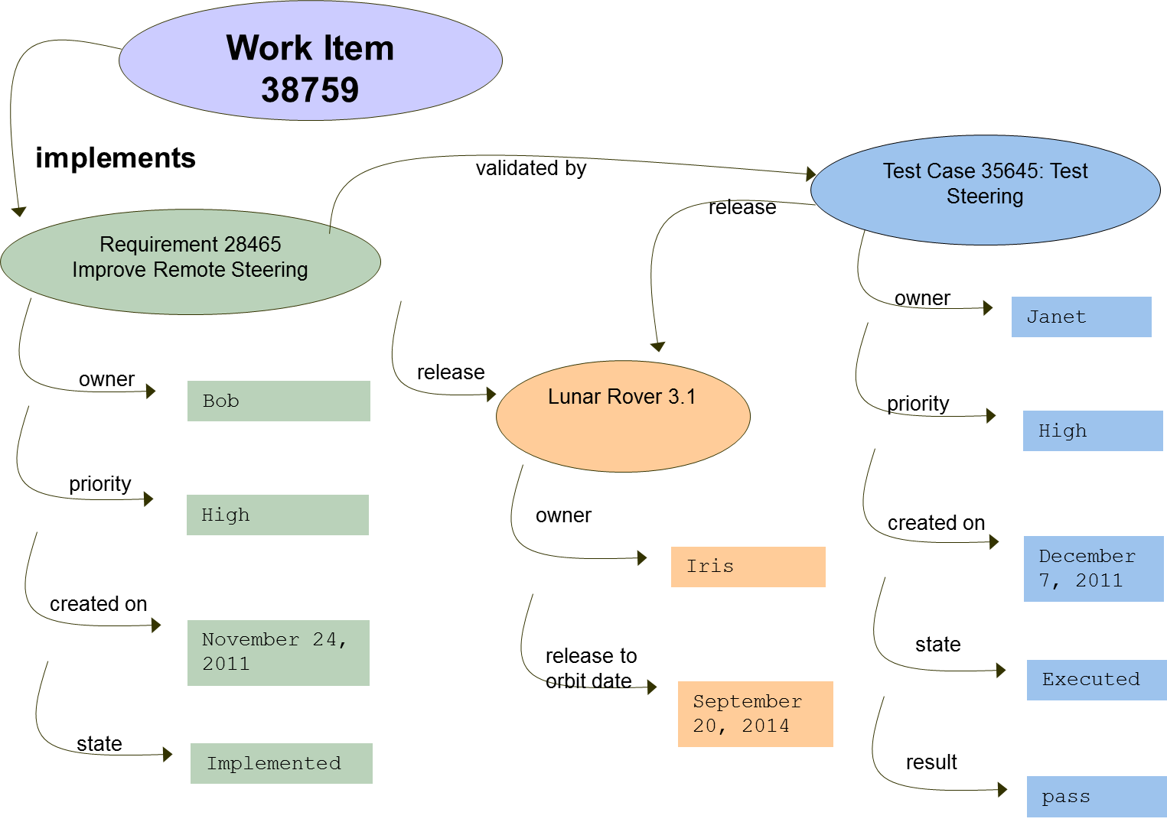
1. The RDF graph data model
Set of triples – leads to an RDF graph
No hierarchical relationships
Notes:
A set of triples forms an RDF graph.
An RDF graph can be visualized as a node and directed-arc diagram, in which each triple is represented as a node-arc-node link.

Slide 23
There is a web of URIs around a development effort
<http://.../build>
<http://.../testresult>
<http://.../build>
<http://.../change request>
<http://.../build>
<http://.../build>
<http://.../build>
<http://.../build>
<http://.../build>
<http://.../build>
<http://.../build>
<http://.../build>
<http://.../req>
<http://.../test case>
<http://.../workitem>
<http://.../testresult>
<http://.../test case>
<http://.../workitem>
<http://.../bug>
<http://.../build>
<http://.../req>
<http://.../change request>
<http://.../build>
<http://.../build>
<http://.../build>
<http://.../build>
<http://.../workitem>
<http://.../test case>
<http://.../bug>
<http://.../release>
<http://.../req>
<http://.../build>
<http://.../build>
validate
<http://.../bug>
<http://.../build>
<http://.../workitem>
<http://.../test case>
<http://.../req>
<http://.../workitem>
<http://.../build>
<http://.../change request>
<http://.../test case>
<http://.../change request>
<http://.../change request>
<http://.../req>
<http://.../testresult>
<http://.../testresult>
<http://.../testresult>
<http://.../change request>

Slide 24
1. The RDF graph data model - Compare to other data models
Compare to other data models
Relational model
object-oriented model
Closed-world assumption vs Open-world assumption
Relational model & object-oriented model
If you are of type X, you must have these properties.
RDF (& the natural world)
If you have these properties, you must be of type X.
→ Implications?
A property in the RDF model is the “first-class citizen”
In the OO model, it’s defined in the context of a class.
Unlike in the OO model
The RDF model does not have methods
All parts of the RDF graph are public.

Slide 25
1. The RDF graph data model - Compare to other data models
Requirement | Owner | Priority | … | Release | Validated by
R28464 … | … | … | … | …
R28465 Improve Remote Steering | Bob | High | … | LR3.1 | TC35645
R28466 … | … | … | … | … | …
Rover Release | Owner | Release to orbit date
Lunar Rover 3.0 | … | …
Lunar Rover 3.1 | Iris | Sept 14, 2014
Test Case | Owner | Priority | ...
Test Case 35645 Test Steering | Janet | High | ...
Lunar Rover 3.1 | … |  | ...
Closed-world assumption vs Open-world assumption
→ Implications?
validated by
Test Case 35645: Test Steering
Requirement 28465 Improve Remote Steering
release
owner
Janet
release
Lunar Rover 3.1
priority
owner
High
Bob
owner
created on
December 7, 2011
priority
High
Iris
created on
release to orbit date
state
November 24, 2011
Executed
September 20, 2014
result
pass
state
Implemented
Notes:
The domains shown:
* requirements domain
* quality domain
* Releases domain
RDF vs. ER data model.

Slide 26
2. URI-based vocabulary
When there is a need to identify anything, use a URI (there are a few exceptions).
Using URIs allows everything to be linked together.
It also allows common agreed-upon meaning for relationships and for resource types
<http://...Test Case 1>
<http://...validates>
<http://...Requirement 1>
Notes:
Note that even the Property/predicate is a URI!
What do you see when you go to that URI? A description of the Property itself.

Slide 27
3. Serialization syntaxes
The RDF model provides for describing RDF triples.
Support for different serialization formats:
Turtle - specialized for RDF
RDF/XML – derived from standard XML
JSON
Notes:
RDF is an abstract model with several serialization formats (i.e., file formats), and so the particular way in which a resource or triple is encoded varies from format to format.

Slide 28
3. Serialization syntaxes - Example
Subject
Predicate
Object
<http://...Test Case 1>
<http://...validates>
<http://...Requirement 1>
<http://example.com/TestCases/1> a oslc_qm:TestCase ;
oslc_qm:validatesRequirement <http://example.com/Requirements/1>
Turtle
{
"rdf:about": "http:\/\/example.com\/TestCases\/1",
"rdf:type": [ {
"rdf:resource": "http:\/\/open-services.net\/ns\/qm#TestPlan"
} ],
"oslc_qm:validatesRequirement": {
"rdf:resource": "http:\/\/example.com\/Requirements\/1"
}
}
JSON
<oslc_qm:TestCase rdf:about="http://example.com/TestCases/1">
<oslc_qm:validatesRequirement rdf:resource="http://example.com/Requirements/1"/>
</oslc_qm:TestCase>
RDF/XML
Notes:
This slide shows the same subject-predicate-object triple example of test case 1 validates requirement 1 represented in different OSLC formats (Turtle, JSON and RDF/XML).

Slide 29
4. Vocabularies
RDF describes resources
→ We need a vocabulary to define the kind of resources (Classes) that can exist and their relationships!
Approaches:
RDF Schema (RDFS)
A basic language framework
Adds classes, subclasses and properties to resources
Web Ontology Language (OWL)
More complex formalised language
uses logic to process information and make deductions.

Slide 30
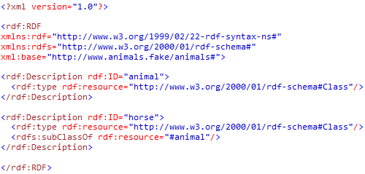
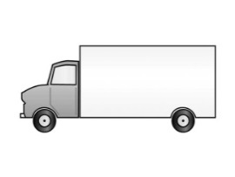

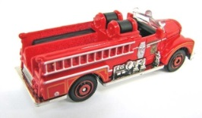
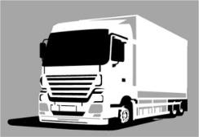
4. Vocabularies - RDF Schema (RDFS)
RDF Schema – an extension of RDF
Provides the framework to describe application-specific classes of resources.
Does not provide actual application-specific classes and properties.
Resources are defined as instances of classes, and subclasses of classes.
Class/metadata
RDFS
Object/data
Object/data
Object/data
RDF
Notes:
We also need a way to define application-specific classes and properties.
Application-specific classes and properties must be defined using extensions to RDF.
One such extension is RDF Schema.
RDF is dealing with objects.
RDFSchema is dealing with classes

Slide 31
4. Vocabularies - Example application-specific classes
Dublin Core Metadata Initiative (DCMI)
Defines a set of properties for describing documents.
Property | Definition
Creator | An entity primarily responsible for making the content of the resource
Title | A name given to the resource
Format | The physical or digital manifestation of the resource
Date | A date of an event in the lifecycle of the resource
Publisher | An entity responsible for making the resource available
Subject | A topic of the content of the resource
…
Notes:
Note that it defines “properties “. Not the subject, nor object. Not the resource/class. Just the property definition.

Slide 32
Linked Data Example - The Linking Open Data project
Links data from open-content projects such as
encyclopaedias and dictionaries
government statistics
bibliographic data
music
research papers
…
Access to data & its semantics
No longer Data Silos
Discoverability
Data discovered and used in unpredictable ways
Linked Data - Structured Data on the Web; by David Wood, Marsha Zaidman, and Luke Ruth; Fig 1.5

Slide 33
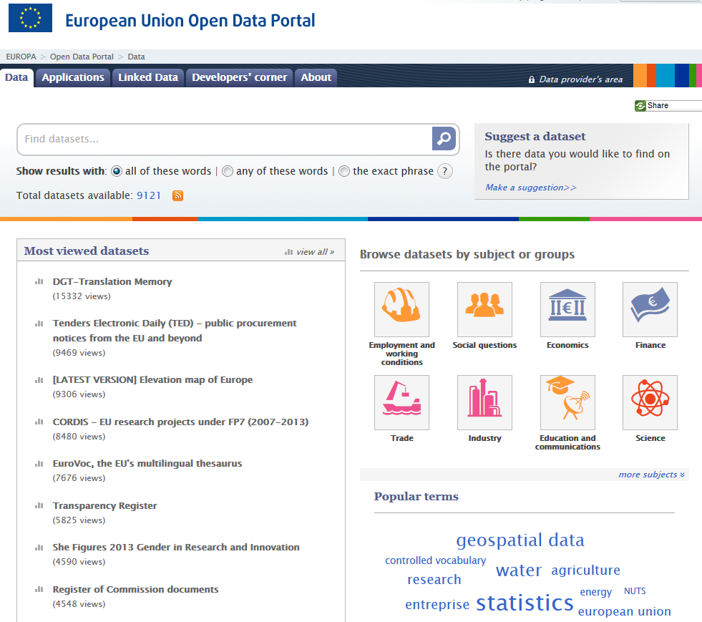
Linked Data Example - Open Data in Government
EU Open Data Portals
Web-based interfaces designed to make it easier to find re-usable information.
Provides search functionalities, & Application Programming Interfaces (APIs) for direct and automated access to data for software applications.
Notes:
Public Sector Information (PSI) Directive
* EU Directive on the re-use of public sector information
* encourages EU member states to make as much public sector information available for re-use as possible

Slide 34
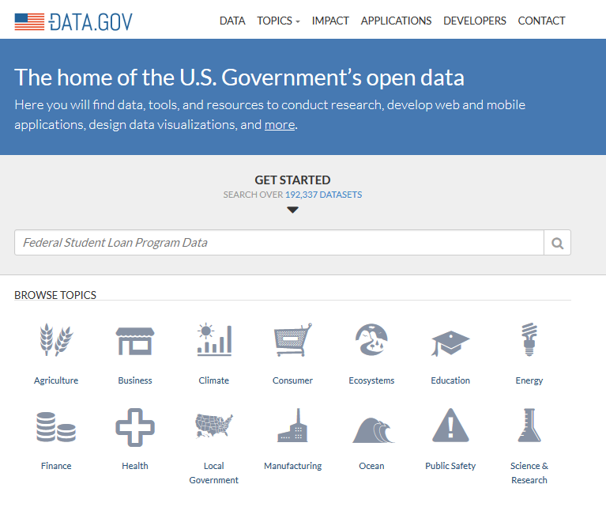
Linked Data Example - Open Data in Government
Data.gov - A U.S. government portal
Powered by two open source applications:
CKAN http://ckan.org/
open-source data portal platform
Makes data accessible – by providing tools to streamline publishing, sharing, finding and using data.
WordPress
https://www.data.gov/about
Notes:
Aims to improve public access to high value, machine readable datasets generated by the Executive Branch of the Federal Government.
The site is a repository for federal government information, made available to the public.

Slide 35
What’s next
The Integration Problem
The OSLC approach
Linked Data and RDF
The OSLC standard
Core specification
domain specification(s)
Requirement Management – an example
… Followed by the Linked Data Tutorial
Notes:
35

Slide 36
OSLC’s Simple Solution
Users can work seamlessly across their tools
*
*
Architecture of the Web
Standard Interfaces
Automation
*
*
Linked Data
“Just Enough” integration
Increased reuse
Increased traceability
Monitoring
Decreased maintenance costs
Better visibility
OSLC is an open and scalable approach to lifecycle integration.
It simplifies key integration scenarios across heterogeneous tools
* Jad’s highlights
Notes:
OSLC tries to find a balance between these 2 extremes of pt-to-pt & single-platform.
It adopts the Arch of the web … which is very scalable.
In particular, it adopts the Linked Data approach of the web.
It aims to standardize the interfaces…
Minimalistic
You do this everyday! Web browser example. + single web page, data sourced from many places … ads, videos, pictures, tweets, comments, content, more links
Linking to application lifecycle data where it is created, instead of copying and synchronizing between tools, is the key insight of OSLC.
Doing so using standard interfaces, on top of a proven architecture, has helped many realize the value of OSLC already.
With OSLC, instead of worrying about integrating specific tools, we focus on composing a set of capabilities.
Animations (OSLC is …):
Approach to integrations
Philosophy of specification development
Set of specifications that tell you what and how to integrate various capabilities
It is also the open community where all this happens
4. Read
This has benefits to professional users (5), business leaders (6) and creators of integrations (7)

Slide 37
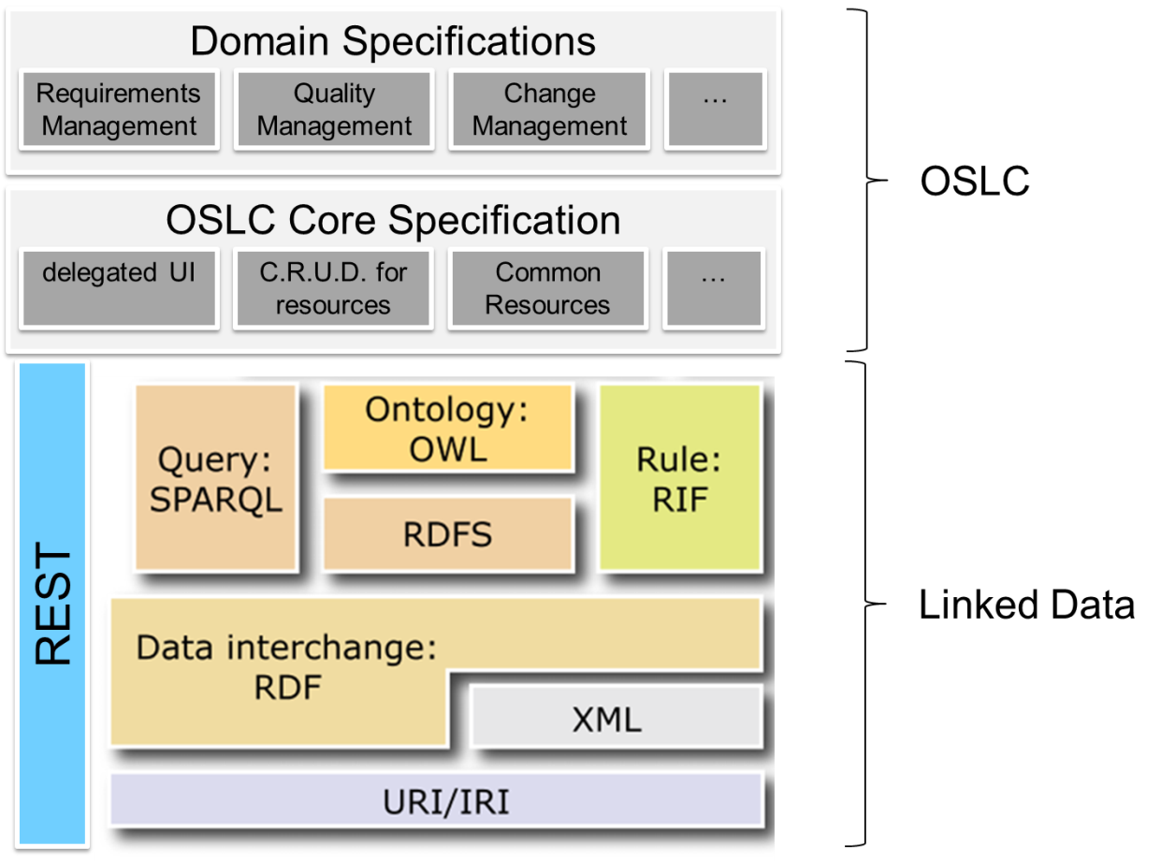
OSLC – relation to Linked Data?
OSLC adopts the Linked Data principles
OSLC links lifecycle data
OSLC adopts the RDF standards and its key concepts
Graph data model
URI-based vocabulary
Serialization syntaxes
…
OSLC Contributes with
The standard rules and patterns for integrating lifecycle tools.
Common approach to perform resource creation, queries, …
Common resource properties
Domain specifications (vocabularies)
resource definitions for Lifecycle tools
Notes:
What Linked Data is: exposing data with relationships
What linked data is NOT:
* updating & creating data
* No standards/agreement on best practices on how to use it.
→ OSLC adds that!

Slide 38
OSLC – relation to Linked Data?
Tim Berners-Lee’s four principles applied to OSLC:
Use URIs as names for things
In OSLC, each artifact in the lifecycle (for example, requirements, change requests, test cases...) is identified by a URI.
Use HTTP URIs so that people can look up those names.
In OSLC, each artifact in the lifecycle is an HTTP resource. Standard HTTP methods (GET, PUT, POST, DELETE) are used to interact with them.
When someone looks up a URI, provide useful information using the standards (RDF*, SPARQL)
Each OSLC resource has an RDF representation. OSLC resources can be queried using SPARQL.
Include links to other URIs so that they can discover more things.
OSLC lifecycle artifacts are linked by relationships (for example, validatesRequirement or testedByTestCase) which are defined by URIs.
Notes:
OSLC applies Tim Berners-Lee’s four principles for linking data, and is based on the industry standard Resource Description Framework (RDF) model.
Now let’s look at how Tim Berners-Lee’s four principles apply to OSLC.

Slide 39
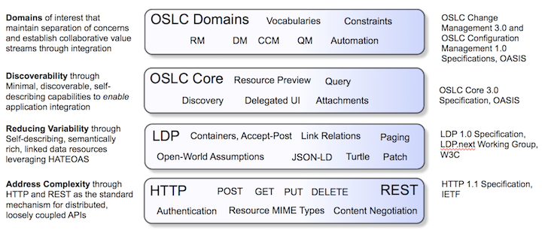
OSLC – relation to Linked Data?
Linked Data

Slide 40
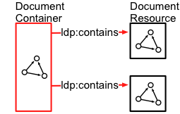
Linked Data Platform (LDP)
A W3C Recommendation
Provides clarifications and extensions of the 4 rules of Linked Data.
Defines a set of rules for HTTP operations on web resources
to provide an architecture for accessing, updating, creating and deleting Linked Data resources from servers.
Main concept – LDP Container
Responds to client requests for creation, modification, and/or enumeration of its linked members and documents.
Notes:
Linked Data does not define rules on HOW to do things. Just WHAT!

Slide 41

Anatomy of OSLC
Core: Specifies the primary integration techniques for integrating lifecycle tools – the standard rules and patterns for using HTTP and RDF that all the domain workgroups must adopt in their specifications
OSLC Core Specification
How
What
OSLC Change Mgt Specification
Domain:
Defines integration scenarios for a given lifecycle topic
Specifies a common vocabulary for the lifecycle artifacts needed to support the scenarios.
OSLC Requirements Specification
OSLC Domain X Specification
Example:
The Core specification describes Delegated UIs and Creation Factories and states that OSLC service providers MAY provide them.
The Change Management specification states that CM service providers MUST provide them.
Notes:
OSLC core specification defines:
How to use HTTP and RDF
How to define resources and services
OSLC domain specifications (Change Management, Requirements, etc.) define:
What resources and services are required in the domain
Resource types, properties and relationships
Service providers, creation factories, query capabilities, operations

Slide 42
What’s next
The Integration Problem
The OSLC approach
Linked Data and RDF
The OSLC standard
Core specification
domain specification(s)
Requirement Management – an example
… Followed by the Linked Data Tutorial
Notes:
42

Slide 43



First, What is a tool? (from an integration perspective)
OSLC Service Provider catalog
Allows for the discovery of the service provider set(s).
They help to simplify the configuration of tools (ex. OAuthConfiguration).
provides
example: IBM Rational Team Concert
OSLC Service Provider
The central organizing concept of OSLC.
Reflects the tool’s containers or partitions
Enables tools to expose resources
Provides access to services (enabling consumers to navigate resources, and create new ones)
example: project, module, …
provides an implementation of
Set of capabilities that enable a web client to create, retrieve, update and delete resources
OSLC Service
example: Change Management capability
manages
Managed by an OSLC Service, may have properties and may link to other resources including those provided by other OSLC Services.
OSLC Resource
example: work item (bug, defect, enhancement request)
Notes:
Service Provider
A tool has generally 1+ organizing concepts that partition the overall space of artifacts in the tool into smaller containers.
Each artifact created in the tool is created within one of these container-like entities
OSLC defines the concept of ServiceProvider to allow products to expose these containers or partitions.

Slide 44

OSLC defines the following technical areas:
1. Discovery of capabilities
2. HTTP C.R.U.D. for resources
6. UI Previews for Resource Links
3. Standard resource representations
5. Delegated UI for Create and Select
4. Querying for resources
Notes:
→ This is what OSLC adds on top of Linked Data.
The technical components of the specification are – HOW HOW HOW

Slide 45
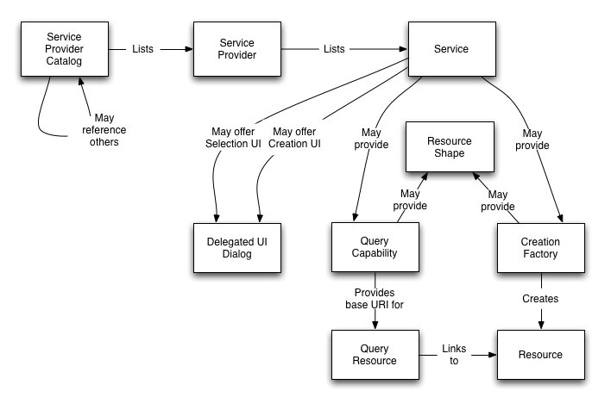
1. Discovery of capabilities
Starting from the catalog you can discover services and their capabilities. This is a common pattern in OSLC.
OSLC capabilities:
Delegated UI Dialog allows you to create or find resources using a UI provided by the OSLC tool
Creation Factory allows you to create resources programmatically
Query Capability allows you to query for resources

Slide 46
2. HTTP C.R.U.D
OSLC allows manipulation of resources using standard HTTP C.R.U.D
Create = POST
Request = GET
Update = PUT
Delete = DELETE
→ OSLC follows the REST architectural pattern.

Slide 47
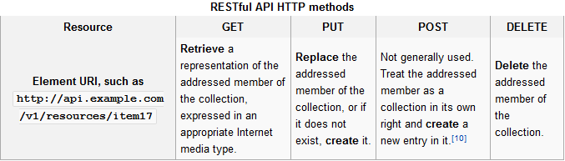
The REST Architectural Pattern
Is a software architecture style for web services.
a simpler alternative to SOAP and WSDL-based Web services
The primary purpose of a RESTful service is to manipulate representations of Web resources using a uniform set of stateless operations.
The design pattern for REST interfaces
Interface with external systems using resources identified by URIs, for example ‘/person/paul’
A resource can be operated upon using standard HTTP verbs (GET, POST, PUT, DELETE).
Architectural constraints
Client-server
Servers and clients may be replaced/developed independently.
Stateless
no client context being stored on the server between requests.
session state is held in the client
…
Source: http://en.wikipedia.org/wiki/Representational_state_transfer
Notes:
Representational State Transfer (REST)
The architecture promotes desirable properties, such as performance, scalability, and modifiability
The REST architectural style constrains
* an architecture to a client/server architecture and
* is designed to use a stateless communication protocol, typically HTTP.

Slide 48
2. HTTP C.R.U.D - Resource Retrieval (Request)
Use HTTP GET and standard HTTP content negotiation
Client uses HTTP Accept request header to specify desired resource formats
Use standard content(MIME) types
Partial representations can be requested via HTTP URL key=value pair as ?oslc.properties=
Allows for minimal retrieval of properties
Get Defect 123 (all properties)
Get Defect 123 (just title and status)
Accept: application/json, application/xml
GET http://bugs/123
GET http://bugs/123?oslc.properties=dcterms:title,oslc_cm:status
Notes:
48

Slide 49
2. HTTP C.R.U.D - Resource Creation (Create)
Create a resource using HTTP POST, with the resource body in format of choice
URI for doing the POST is defined in the oslc:ServiceProvider in the oslc:creationFactory service
Response is a 201-Created with Location HTTP header indicating URI for resource
Request may be rejected for any number of reasons
Insufficient permissions
Missing required values
Invalid data choices
...and … and ...
Valid resource formats for creation are defined by:
domain specifications
service provider may define its own resources and formats
optionally, by resource shape associated with creation factory
Notes:
49

Slide 50
2. HTTP C.R.U.D - Resource Modification (Update)
Use HTTP GET to get resource properties to be updated
You’ll get an ETag back
Change only the property values you need to change
Clients must preserve unknown content
Use HTTP PUT to send updated resource
Use If-Match HTTP request header with ETag, services may reject your request without it
HTTP PUT will completely replace the resource representation
We are moving towards PATCH – new HTTP verb http://tools.ietf.org/html/rfc5789
It is possible to update only selected properties
Notes:
50

Slide 51
2. HTTP C.R.U.D - Resource Deletion (Delete)
Use HTTP DELETE on the resource identifier
May not be allowed
Response usually:
200-OK
204-No-Content
400-Bad-Request
403-Forbidden

Slide 52
3. Resource representations
OSLC services should handle any type of resource
Not just those defined by OSLC
Resources defined by OSLC use RDF data model
therefore are simply defined by their set of properties
OSLC services MUST produce and consume RDF/XML representations
Clients and services MUST NOT assume any subset of RDF/XML
Other representations are allowed such as:
XML: OSLC defined format that allows for consistent formats and is RDF/XML valid
JSON: Rules for representing namespaces and QName properties
Turtle: No constraints, use as is (may be preferred by future specs)
Atom Syndication Format: <atom:content> SHOULD be RDF/XML
Notes:
52

Slide 53
3. Resource representations - A few words on link properties
Turtle format for a bug resource (abbreviated)
<http://example.com/bugs/2314>
a oslc_cm:ChangeRequest ;
dcterms:relation <http://server/app/bugs/1235> ;
Links are properties where the property values are URIs
Don't make assumptions about the target of links
OSLC supports an open model
Needed to achieve goal of “loosely coupled” integrations
Clients need to be flexible and expect anything
Notes:
53
http://open-services.net/bin/view/Main/OslcCoreSpecAppendixLinks

Slide 54
4. Querying for resources
Query capability has base URI
Clients form query URI and HTTP GET the results
OSLC services MAY support OSLC Query Syntax
http://open-services.net/bin/view/Main/OSLCCoreSpecQuery
Notes:
54

Slide 55
Query syntax overview
Filter results by appending “oslc.where=” with query clause to query base URI
Only boolean operation allowed is “and” which represents conjunction
“or” for disjunction is not defined in the interests of keeping the syntax simple.
Retrieve just what you want with “oslc.select=”
Defined ordering using “oslc.orderBy=”
Full-text search via “oslc.searchTerms=”
Comparison Operators
= test for equality
!= test for inequality
< test less-than
> test greater-than
<= test less-than or equal
>= test greater-than or equal
'in' operator:
Test for equality to any of the values in a list. The list is a comma-separated sequence of values, enclosed in square brackets: in [“high”,”critical”]
Notes:
55

Slide 56
Query syntax example
http://example.com/bugs?oslc.where=
cm:severity="high" and dcterms:created>"2010-04-01"
http://example.com/bugs?oslc.prefix=qm=
<http://qm.example.com/ns>&
oslc.where=qm:testcase=<http://example.com/tests/31459>
http://example.com/bugs?oslc.where=
dcterms:creator{
foaf:givenName="John" and foaf:familyName="Smith"}
Find high severity bugs created after April fools day
Find bugs related to test case 31459
Find all bugs created by John Smith
Notes:
56

Slide 57
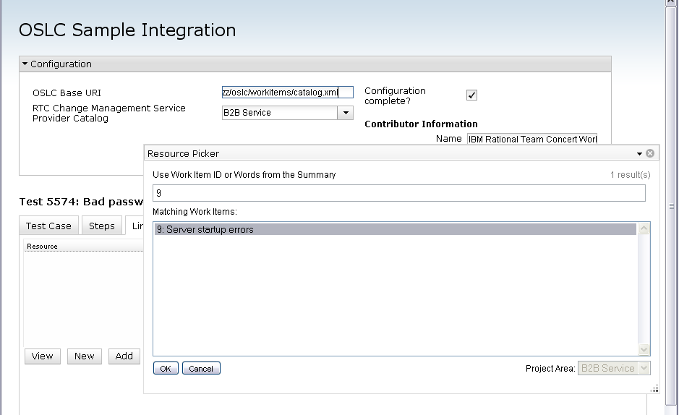
5. Delegated UI for Create and Select
Delegated UI - renders the source application UI in the target application.
2. iframe's src set to delegated UI's URL
1. Click to launch Create delegated UI
4. Click OK. Sends message (link+label) to parent window
3. Selection made
Notes:
57
A delegated UI renders the source application UI in the target application.

Slide 58
Delegated UI key points
Delegated UIs support both creation and selection of resources
Two communication protocols are supported for iframes:
HTML5 postMessage() ← preferred method
Supported in most modern browers
Window object's window.name
Supported in older browsers and Eclipse embedded web widget
Consumer selects which protocol to use, informs provider via fragment identifier
Tremendous value for resource creation
Traditionally most service logic was communicated to client and new dialog built
Now the rules for creation and dialog change as needed
Prefilling of creation dialog done by “creating” a dialog resource
HTTP POST of resource format to creation dialog URL, response is URL of dialog prefilled
Notes:
58

Slide 59
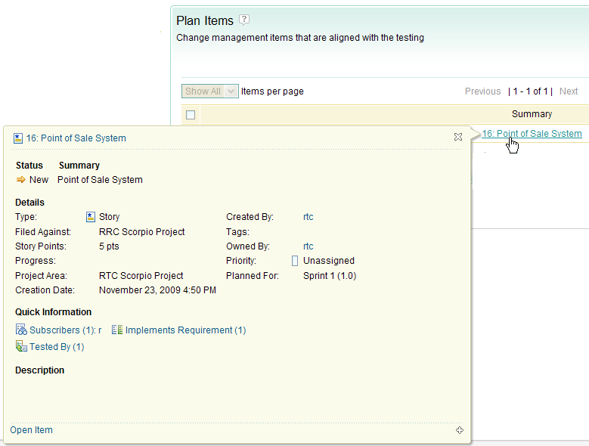
6. UI Preview
Scenario supported: hover over link to get in context preview of resource
Hover over link
Notes:
59
Small and large previews provided for. Hover “gesture” an implementation detail, i.e. you can activate/retrieve the preview whenever it makes sense.

Slide 60
What’s next
The Integration Problem
The OSLC approach
Linked Data and RDF
The OSLC standard
Core specification
domain specification(s)
Requirement Management – an example
… Followed by the Linked Data Tutorial
Notes:
60

Slide 61
Domain specification(s)
OSLC Specifications Cover Many Domains
Architecture Management
Asset Management
Automation
Change Management
Configuration Management
Quality Management
Requirements Management
…
See http://open-services.net/specifications/
Notes:
… and there is no reason for them not to cover more!
Contribute scenarios and propose new domain workgroups.

Slide 62
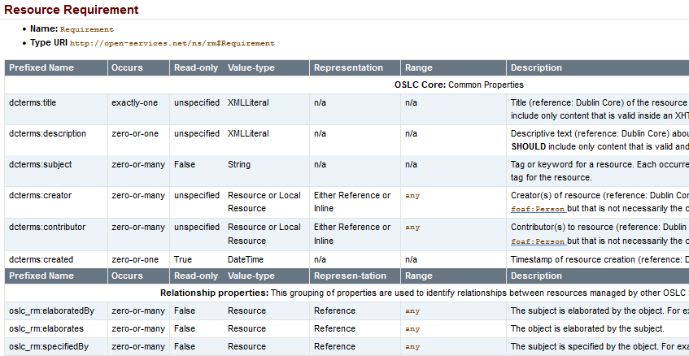
Requirements Management
http://open-services.net/bin/view/Main/RmSpecificationV2
Defining a Resource & its Properties
Notes:
How to define a resource?
1. Give it a name & a Type URI
2. List its properties, specifying for each property (a) its type, (b) cardinality (c) range, …

Slide 63
What’s next
The Integration Problem
The OSLC approach
Linked Data and RDF
The OSLC standard
Core specification
domain specification(s)
Requirement Management – an example
… Followed by the Linked Data Tutorial
Notes:
63

